Slide 1

Department of Computer Science
University Institute of Engineering
DEPARTMENT OF COMPUTER SCIENCE & ENGINEERING
Bachelor of Engineering
Subject Name: Software Engineering
Subject Code: CST-220
Quality Management
DISCOVER . LEARN . EMPOWER

Slide 2
Introduction to Software Engineering
Department of computer Science
Course Outcome
CO Number | Title | Level
C01 | Students will be able to learn how to apply the software engineering lifecycle by demonstrating competence in communication, planning, analysis, design, construction, and deployment. | Understand
C02 | Students will be able to gain knowledge of software design and UI design. | Understand
CO3 | Students will be able to apply testing guidelines. | Understand

Slide 3
Chapter-8 Quality Management
Department of computer Science
SEICMM

Slide 4
Capability maturity model (CMM)
CMM was developed by the Software Engineering Institute (SEI) at Carnegie Mellon University in 1987.
It is not a software process model. It is a framework which is used to analyze the approach and techniques followed by any organization to develop software products.
It also provides guidelines to further enhance the maturity of the process used to develop those software products.

Slide 5
Capability maturity model (CMM)
It is based on profound feedback and development practices adopted by the most successful organizations worldwide.
This model describes a strategy for software process improvement that should be followed by moving through 5 different levels.
Each level of maturity shows a process capability level. All the levels except level-1 are further described by Key Process Areas (KPA’s).

Slide 6
Key Process Areas
Each of these KPA’s defines the basic requirements that should be met by a software process in order to satisfy the KPA and achieve that level of maturity.
Conceptually, key process areas form the basis for management control of the software project and establish a context in which technical methods are applied, work products like models, documents, data, reports, etc. are produced, milestones are established, quality is ensured and change is properly managed.

Slide 7
Levels of CMM
The 5 levels of CMM are as follows:
Level-1: Initial –
No KPA’s defined.
Processes followed are adhoc and immature and are not well defined.
Unstable environment for software development.
No basis for predicting product quality, time for completion, etc.

Slide 8
Levels of CMM
Level-2: Repeatable –
Focuses on establishing basic project management policies.
Experience with earlier projects is used for managing new similar natured projects.
Project Planning- It includes defining resources required, goals, constraints, etc. for the project. It presents a detailed plan to be followed systematically for successful completion of a good quality software.
Configuration Management- The focus is on maintaining the performance of the software product, including all its components, for the entire lifecycle.
Requirements Management- It includes the management of customer reviews and feedback which result in some changes in the requirement set. It also consists of accommodation of those modified requirements.
Subcontract Management- It focuses on the effective management of qualified software contractors i.e. it manages the parts of the software which are developed by third parties.
Software Quality Assurance- It guarantees a good quality software product by following certain rules and quality standard guidelines while development.

Slide 9
Levels of CMM
Level-3: Defined –
At this level, documentation of the standard guidelines and procedures takes place.
It is a well defined integrated set of project specific software engineering and management processes.
Peer Reviews- In this method, defects are removed by using a number of review methods like walkthroughs, inspections, buddy checks, etc.
Intergroup Coordination- It consists of planned interactions between different development teams to ensure efficient and proper fulfillment of customer needs.
Organization Process Definition- It’s key focus is on the development and maintenance of the standard development processes.
Organization Process Focus- It includes activities and practices that should be followed to improve the process capabilities of an organization.
Training Programs- It focuses on the enhancement of knowledge and skills of the team members including the developers and ensuring an increase in work efficiency.

Slide 10
Levels of CMM
Level-4: Managed –
At this stage, quantitative quality goals are set for the organization for software products as well as software processes.
The measurements made help the organization to predict the product and process quality within some limits defined quantitatively.
Software Quality Management- It includes the establishment of plans and strategies to develop a quantitative analysis and understanding of the product’s quality.
Quantitative Management- It focuses on controlling the project performance in a quantitative manner.

Slide 11
Levels of CMM
Level-5: Optimizing –
This is the highest level of process maturity in CMM and focuses on continuous process improvement in the organization using quantitative feedback.
Use of new tools, techniques and evaluation of software processes is done to prevent recurrence of known defects.
Process Change Management- Its focus is on the continuous improvement of organization’s software processes to improve productivity, quality and cycle time for the software product.
Technology Change Management- It consists of identification and use of new technologies to improve product quality and decrease the product development time.
Defect Prevention- It focuses on identification of causes of defects and to prevent them from recurring in future projects by improving project defined process.

Slide 12
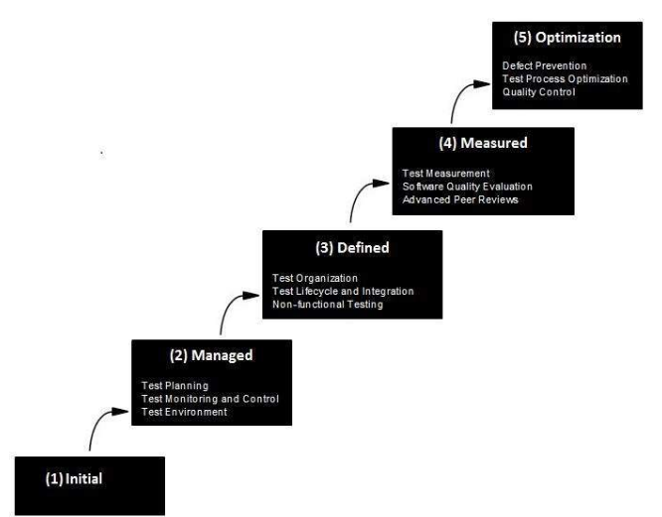

Slide 13
References
Department of computer Science
https://www.geeksforgeeks.org/software-engineering-capability-maturity-model-cmm/
https://www.javatpoint.com/software-engineering-institute-capability-maturity-model
https://www.tutorialspoint.com/software_testing_dictionary/capability_maturity_model.htm

Slide 14
THANK YOU

